Slide 1
Fuel cell
A fuel cell is a device that converts the chemical energy from a fuel into electricity through a chemical reaction with oxygen or another oxidizing agent
There are many types of fuel cells, but they all consist of an anode (negative side), a cathode (positive side) and an electrolyte that allows charges to move between the two sides of the fuel cell and
Its include Container, separator, sealing separator and oxidant supply
Heat is produced from chemical reaction and not from combustion.

Slide 2
A fuel, such as hydrogen, is fed to the anode, and the air is fed to the cathode.
In a hydrogen fuel cell, a catalyst at the anode separates hydrogen molecules into protons and electrons, which take different paths to the cathode.
The electrons go through an external circuit, creating a flow of electricity.
https://www.youtube.com/watch?v=a4pXAmljdUA

Slide 3

HISTORY
Considered a curiosity in the 1800’s.
The first fuel cell was built in 1839 by Sir William Grove, a lawyer and gentleman scientist. Serious interest in the fuel cell as a practical generator did not begin until the 1960's, when the U.S.
space program chose fuel cells over riskier nuclear power and more expensive solar energy.
Fuel cells furnished power for the Gemini and Apollo space craft, and still provide electricity and water for the space shuttle.

Slide 4
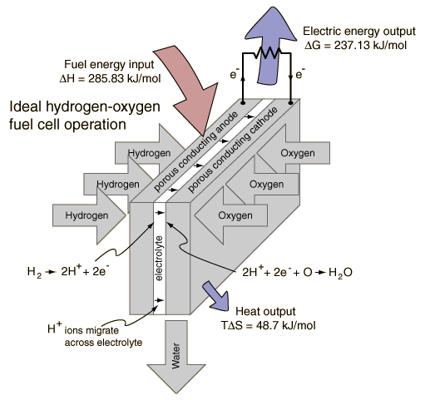
Fuel Cell Basics
https://www.youtube.com/watch?v=8xeB_O_fyzM

Slide 5
Fuel Cell Basics
Components
Anode: Where the fuel reacts or "oxidizes", and releases electrons.
Cathode: Where oxygen (usually from the air) "reduction" occurs.
Electrolyte: A chemical compound that conducts ions from one electrode to the other inside a fuel cell.
Catalyst: A substance that causes or speeds a chemical reaction without itself being affected.
Cogeneration: The use of waste heat to generate electricity. Harnessing otherwise wasted heat boosts the efficiency of power-generating systems.
Reformer: A device that extracts pure hydrogen from hydrocarbons.
Direct Fuel Cell: A type of fuel cell in which a hydrocarbon fuel is fed directly to the fuel cell stack, without requiring an external "reformer" to generate hydrogen.

Slide 6
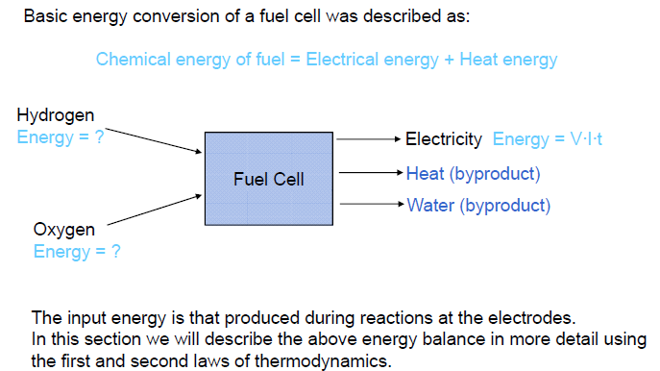
https://www.youtube.com/watch?v=a4pXAmljdUA

Slide 7
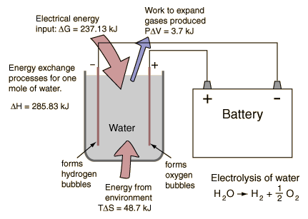
Electrolysis
“What does this have to do with fuel cells?”
The familiar process of electrolysis requires work to proceed, if the process is put in reverse, it should be able to do work for us spontaneously.
fuel
cell
O₂
H₂O
H₂
heat
Figure 1
Anode Reaction: 2H₂ + 2O²⁻ → 2H₂O + 4e⁻
Cathode Reaction: O₂ + 4e– → 2O²⁻
Overall Cell Reaction: 2H₂ + O₂ → 2H₂O

Slide 8
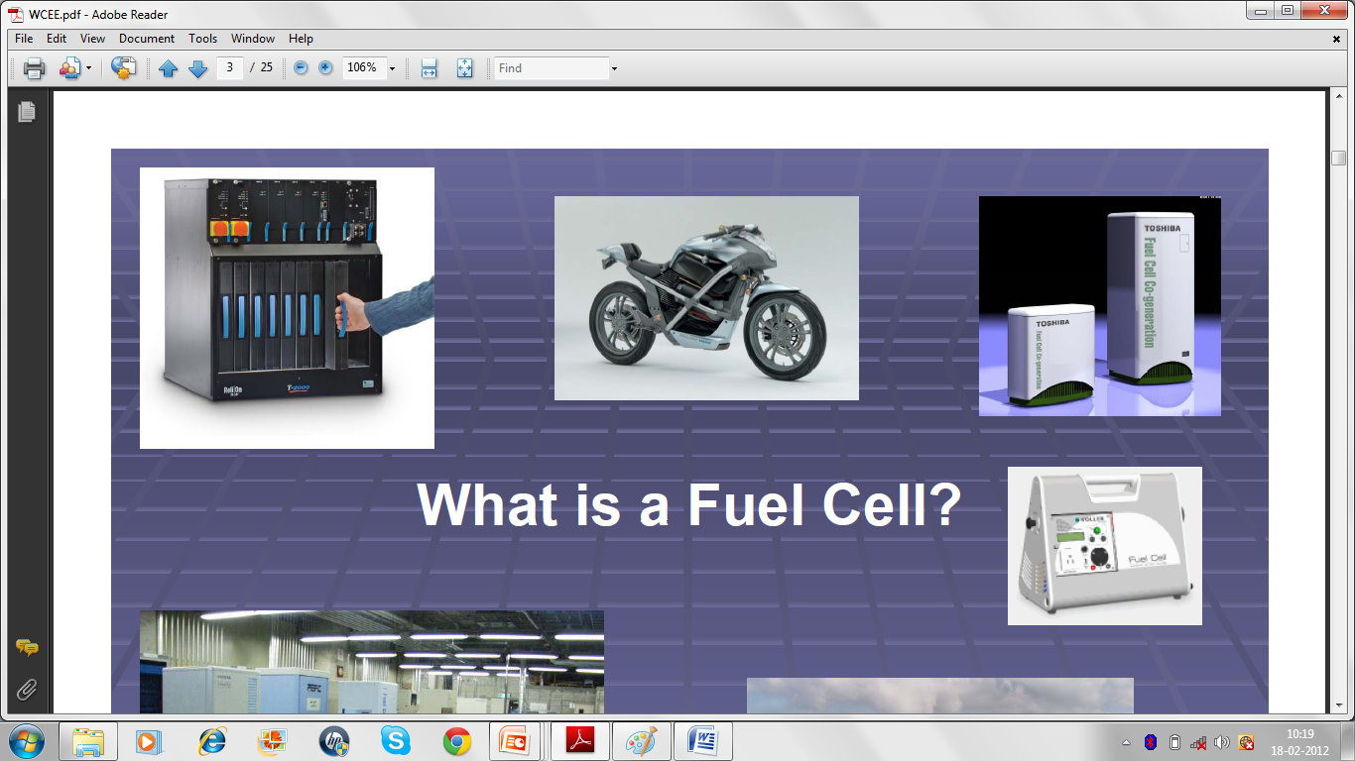
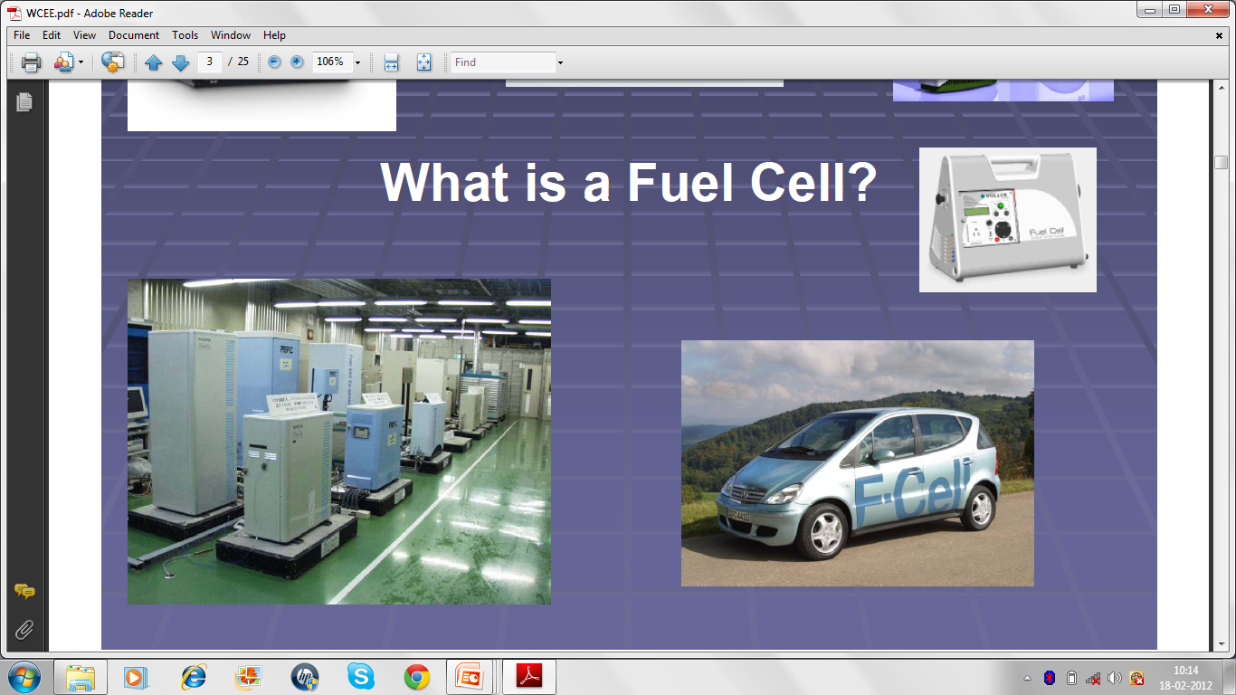
Fuel cells combine hydrogen and oxygen electrochemically to produce electricity. The only by-products are water and useful heat.
Applications in almost every energy-utilizing plant and/or device.
Power plants to cars
Homes, from laptop computers to mobile phones.

